Slide 1
7. Self-Organizing Maps
7.1 Self-organization
7.2 Self-organizing maps
7.3 SOM algorithm
7.4 Properties of the feature map
7.5 SOM discussion & examples
7.6 MATLAB Live Script examples

Slide 2
Introduction
We discussed so far neural networks that were trained to perform a mapping INPUTS → OUTPUTS which corresponds to a supervised learning paradigm
However, problems exist where target outputs are not available → the only information is provided by a set of input patterns
INPUTS → ?? which corresponds to an unsupervised learning paradigm

Slide 3
Examples of problems
Clustering
Input data are grouped into clusters → for any input, neural net should return a corresponding cluster label
Vector quantization
Continuous space has to be discretized → neural net has to find optimal discretization of the input space
Dimensionality reduction
Input data are grouped in a subspace with lower dimensionality than the original data → Neural net has to learn an optimal mapping such that most of the variance in the input data is preserved in the output data
Feature extraction
The system has to extract features from the input signal → this often means a dimensionality reduction as described above

Slide 4
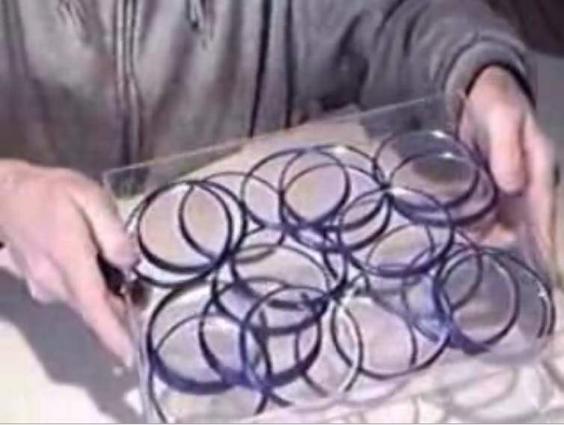
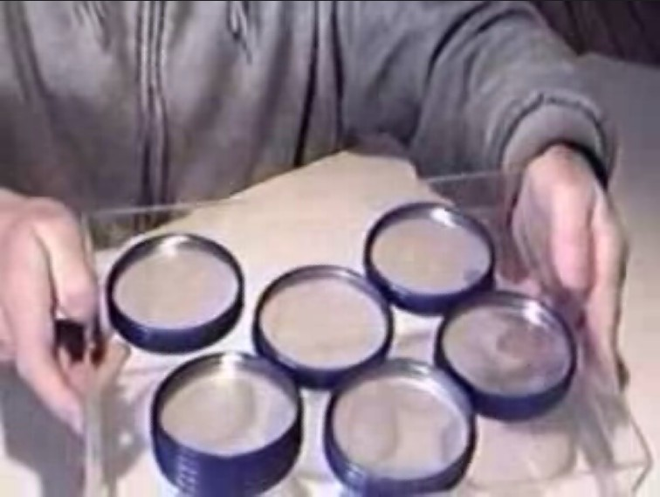
7.1 Self-organization
What is self-organization?
System structure appears without explicit pressure or involvement from outside the system
Constraints on the form (i.e. organization) of interest to us are internal to the system, resulting from the interactions among the components
The organization can evolve in either time or space, maintain a stable form or show transient phenomena
Example of self-organizing yogurt lids: https://youtu.be/_h_G6krZym4
Notes:
https://youtu.be/_h_G6krZym4

Slide 5
Self-organization properties
Typical features include (in rough order of generality)
Autonomy (absence of external control)
Dynamic operation (evolution in time)
Fluctuations (noise / searches through options)
Symmetry breaking (loss of freedom)
Global order (emergence from local interactions)
Dissipation (energy usage / far-from-equilibrium)
Instability (self-reinforcing choices / nonlinearity)
Multiple equilibria (many possible attractors)
Criticality (threshold effects / phase changes)
Redundancy (insensitivity to damage)
Self-maintenance (repair / reproduction metabolisms)
Adaptation (functionality / tracking of external variations)
Complexity (multiple concurrent values or objectives)
Hierarchies (multiple nested self-organized levels)

Slide 6

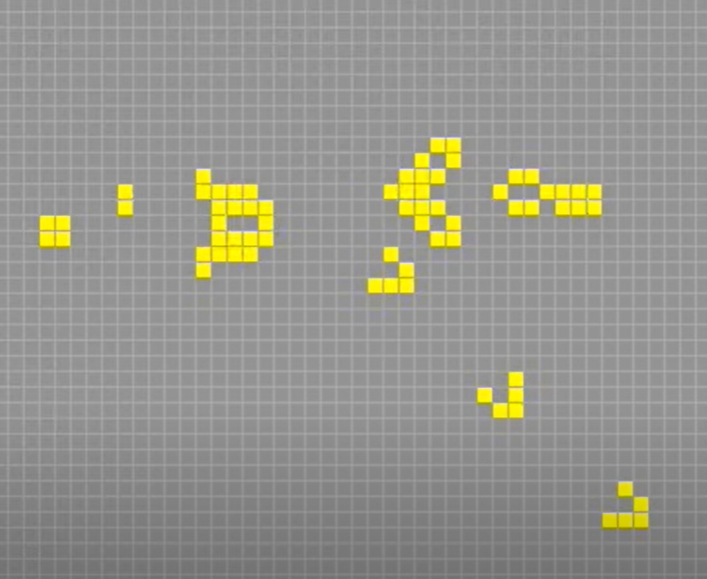
John Conway’s Game of Life
John Conway published in 1970 a paper in Scientific American about the Game of Life
An infinite two-dimensional grid of square cells,
Each cell is in one of two possible states, alive or dead,
Every cell interacts with its eight neighbors
RULES:
Alive cell with less than 2 or more than 4 neighbors dies (loneliness / overcrowding)
Dead cell with 3 neighbors turns alive (reproduction)
Simple rules can result in extraordinary complexity https://youtu.be/23MBR2pZoDQ
Glider Gun creating gliders
Notes:
https://youtu.be/23MBR2pZoDQ

Slide 7
Self-organization in neural networks
Self-organizing networks are based on competitive learning
output neurons of the network compete to be activated and only one neuron can become a winning neuron
Self-organizing maps (SOM)
learn to recognize groups of similar input vectors in such a way that neurons physically near each other in the neuron layer respond to similar input vectors
Learning vector quantization (LVQ)
a method for training competitive layers in a supervised manner
learns to classify input vectors into target classes chosen by the user
Notes:
http://www.calresco.org/sos/sosfaq.htm

Slide 8
Neurobiological motivation
Neurobiological studies indicate that different sensory inputs (tactile, visual, auditory, etc.) are mapped onto different areas of the cerebral cortex in an ordered fashion
This form of a map, known as a topographic map, has two important properties:
At each stage of representation, or processing, each piece of incoming information is kept in its proper context / neighborhood
Neurons dealing with closely related pieces of information are kept close together so that they can interact via short synaptic connections
Our interest is in building artificial topographic maps that learn through self-organization in a neurobiologically inspired manner
We shall follow the principle of topographic map formation: The spatial location of an output neuron in a topographic map corresponds to a particular domain or feature drawn from the input space

Slide 9
7.2 Self-organizing maps (SOM)
Neurons are placed at the nodes of a lattice, usually 1D or 2D
Neurons are trained by a self-organized competitive learning rule
Neurons become selectively tuned to various input patterns or classes of input patterns
Locations of neurons become ordered in a way that a meaningful topographic map of input patterns is created
The process of ordering is automatic (self-organized) without guidance from outside
Self-organizing maps are inherently nonlinear → a nonlinear generalization of principal component analysis (PCA)
Notes:
lattice = rešetka, mreža

Slide 10
Organization of a self-organizing map
Points x from the input space are mapped to points I(x) in the output space (self-organizing map)
Each point I in the output space will map to a corresponding point w(I) in the input space

Slide 11
Kohonen network
Kohonen (1982): Self-organized formation of topologically correct feature maps. Biological Cybernetics
Kohonen network or Self-Organizing Map (SOM) has a single computational layer arranged in rows and columns
1D, 2D, 3D
Each neuron is fully connected to all source nodes in the input layer
Notes:
https://link.springer.com/article/10.1007/BF00337288

Slide 12
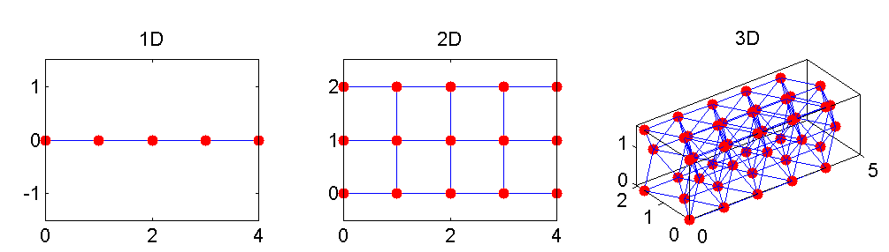
SOM architecture
Calculating the distance between inputs and neurons
dist
Competitive layer → selection of a winning neuron and its neighborhood
dist, linkdist, mandist, boxdist
Topologies:
1D, 2D, 3D

Slide 13
7.3 SOM algorithm
Initialization Define SOM topology, then initialize weights with small random values
Competition For each input pattern, neurons compute their values of a distance function which provides the basis for competition. A neuron with the smallest distance to the input pattern is declared the winner.
Cooperation The winning neuron determines the topological neighborhood of excited neurons, thereby providing the basis for cooperation among neighboring neurons
Adaptation Excited neurons decrease their distance to the input pattern through adjustment of synaptic weights → response of the winning neuron to the subsequent application of a similar input pattern is enhanced

Slide 14
Competition - Cooperation - Adaptation
We have m-dimensional input space
Synaptic weight vector of each neuron in the network has the same dimension as input space
The best match of the input vector x with the synaptic weight vectors w_{j} can be found by comparing the Euclidean distance between input vector x and each neuron j
Neuron whose weight vector comes closest to the input vector (i.e. is most similar to it) is declared the winning neuron
In this way the continuous input space can be mapped to the discrete output space of neurons by a simple process of competition between the neurons

Slide 15
Competition - Cooperation - Adaptation
Winning neuron locates the center of a topological neighborhood of cooperating neurons
Neurobiological studies confirm that there is lateral interaction within a set of excited neurons
When one neuron fires, its closest neighbors tend to get excited more than those further away
Topological neighborhood decays with distance
We define a similar neurobiologically correct topological neighborhood for the neurons in SOM and assume two requirements:
Topological neighborhood is symmetric around the winning neuron
Amplitude of the topological neighborhood decreases monotonically with increasing lateral distance (and decaying to zero in the limit d→∞ which is necessary for convergence)

Slide 16
Competition - Cooperation - Adaptation
A typical choice of a topological neighborhood function that covers both requirements is defined by the Gaussian function
Gaussian function is translation invariant (independent of the location of the winning neuron)
Effective width of the topological neighborhood

Slide 17
Competition - Cooperation - Adaptation
For cooperation to be effective, a topological neighborhood must depend on the lateral distance between the winning neuron and its neughbors in the output space and NOT on distance measure in the original input space
Neighbors
Winning neuron
Distance:
dist
linkdist
mandist
boxdist

Slide 18
Competition - Cooperation - Adaptation
Another special feature of the SOM algorithm is that size of the topological neighborhood shrinks with time
Shrinking requirement is fulfilled by decreasing the width σ of the Gaussian neighborhood function with time. A popular choice is exponential temporal decay
Consequently, topological neighborhood function assumes a time-varying form
Time increases → width decreases → neighborhood shrinks

Slide 19
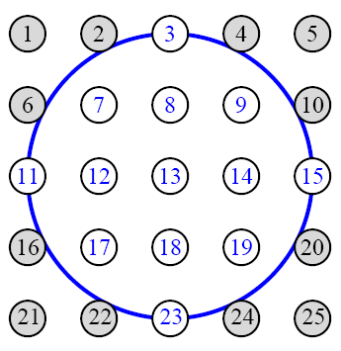
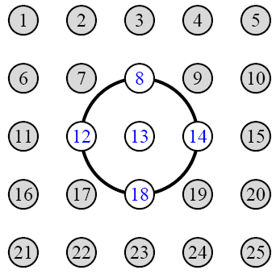
Competition - Cooperation - Adaptation
Time increases → width decreases → neighborhood shrinks

Slide 20
Competition - Cooperation - Adaptation
Clearly, SOM must involve some kind of adaptation or learning by which the outputs become self-organized and the feature map between inputs and outputs is formed
Meaning of the topographic neighborhood is that not only the winning neuron gets its weights updated, but its neighbors will have their weights updated as well
Learning rule for adaptation
the rule is applied to all neurons inside the topological neighborhood of the winning neuron i
Adaptation moves the synaptic weights w_{j} of the chosen neurons toward the input vector x
Notes:
Learning constant: eta

Slide 21
Competition - Cooperation - Adaptation
Adaptation algorithm leads to a topological ordering of the feature map – neurons that are neighbors in the lattice will tend to have similar weight vectors
Learning parameter η(n) should be decreasing with time for a proper convergence
Thus, SOM algorithm requires a choice of several parameters: Even if not optimal, selection of parameters usually leads to the formation of the feature map in a self-organized manner

Slide 22
Competition - Cooperation - Adaptation
Adaptation process can be decomposed into two phases
Self-organizing or ordering phase
Topological ordering of weight vectors → typically 1000 iterations of the SOM algorithm → needs proper choice of neighborhood function and learning rate
Convergence phase
Feature map fine-tuning → provides statistical quantification of the input space → typically the number of iterations at least 500 times the number of neurons
Result of the SOM algorithm
→ Starting from the initial state of complete disorder, the SOM algorithm gradually leads to an organized representation of activation patterns drawn from the input space
However, it is possible to end up in a metastable state in which the feature map has a topological defect

Slide 23
SOM algorithm essentials
Essential characteristics of the SOM algorithm:
Continuous input space of activation patterns that are generated according to a certain probability distribution
Discrete output space in a form of a lattice of neurons
Shrinking neighborhood function h that is defined around a winning neuron
Decreasing learning rate that is exponentially decreasing with time

Slide 24
SOM algorithm summary
Initialization Choose random values for the initial weight vectors w_{j}
Sampling Draw a sample training input vector x from the input space
Competition Find the winning neuron with weight vector closest to input vector
Cooperation Select neurons in the topological neighborhood of the winning neuron
Adaptation Adjust synaptic weights of the selected neurons
Iteration Continue with step 2 until the feature map stops changing

Slide 25
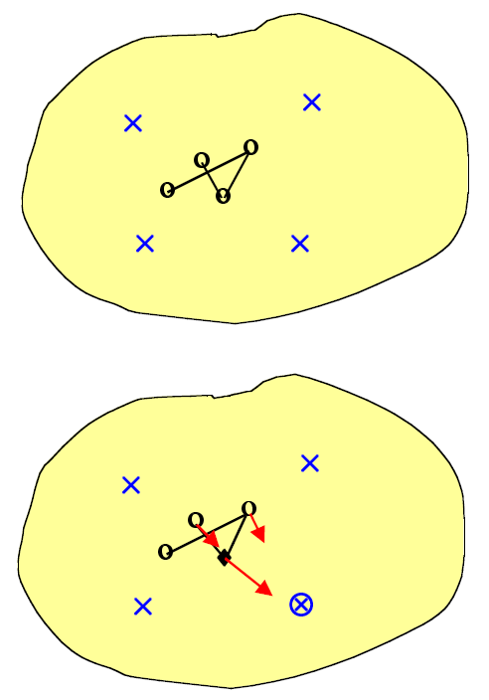
Visualizing the SOM algorithm (1/2)
Step 1
Suppose we have four data points (x) in our continuous 2D input space, and want to map this onto four points in a discrete 1D output space (o). The output nodes map to points in the input space (o). Random initial weights start the circles at random positions in the center of the input space.
Step 2
We randomly pick one of the data points for training (). The closest output point represents the winning neuron (♦). That winning neuron is moved towards the data point by a certain amount, and the two neighboring neurons move by smaller amounts (→).

Slide 26
Visualizing the SOM algorithm (2/2)
Step 3
Next, we randomly pick another data point for training (). The closest output point gives the new winning neuron (♦). The winning neuron moves towards the data point by a certain amount and the one neighboring neuron moves by a smaller amount (→).
Step 4
We carry on randomly picking data points for training (). Each winning neuron moves towards the data point by a certain amount and its neighboring neuron(s) move by smaller amounts (→). Eventually, the whole output grid unravels itself to represent the input space.

Slide 27
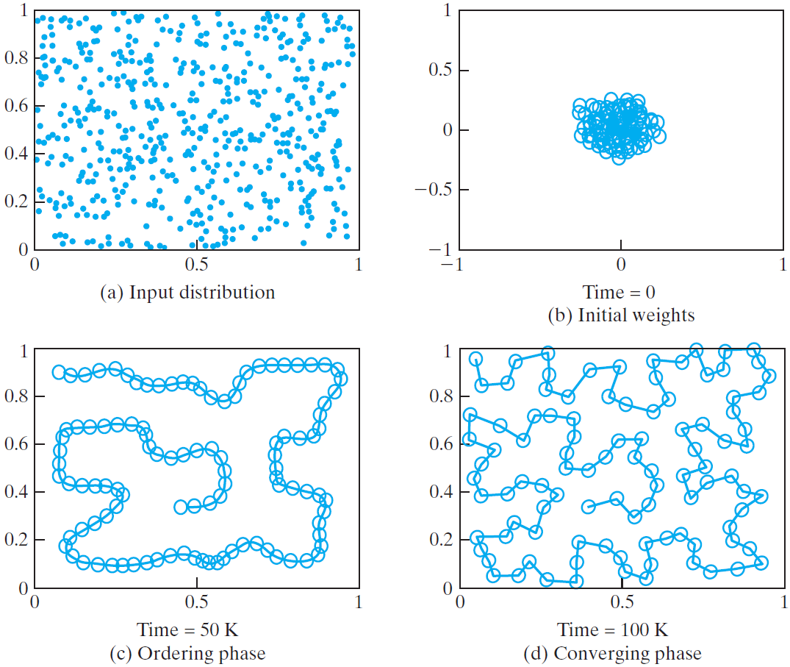
Example: 1D Lattice driven by 2D distribution
2D input data distribution
Initial condition of 1D lattice
End of ordering phase
End of convergence phase
Notes:
Image: Simon Haykin (2009) Neural Networks and Learning Machines

Slide 28
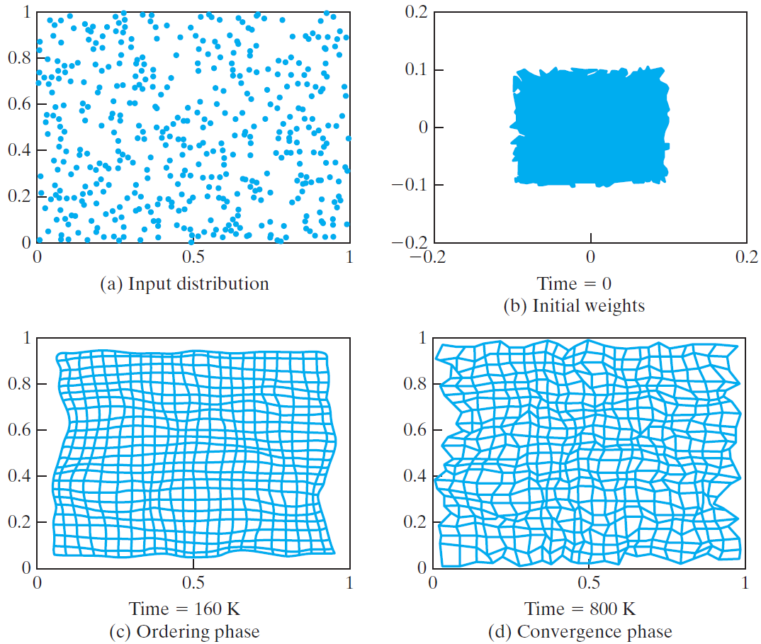
Example: 2D Lattice driven by 2D distribution
2D input data distribution
Initial condition of 2D lattice
End of ordering phase
End of convergence phase
Notes:
Image: Simon Haykin (2009) Neural Networks and Learning Machines

Slide 29
Parameters for 1D example
Exponential decay of neighborhood width σ(n)
Exponential decay of learning rate η(n)
Initial neighborhood function (spanning over 100 neurons)
Final neighborhood function at the end of the ordering phase

Slide 30
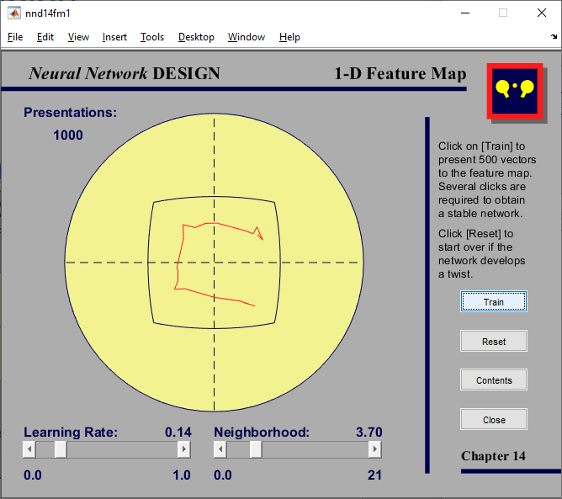
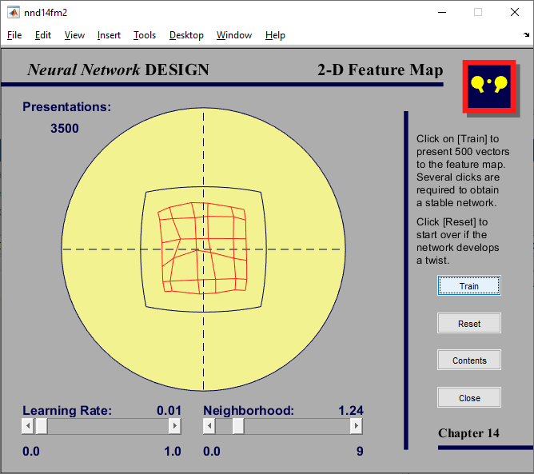
MATLAB examples
nnd14fm1 – 1D feature map
nnd14fm2 – 2D feature map

Slide 31
7.4 Properties of the feature map
Property 1: Approximation of the input space
Property 2: Topological ordering
Property 3: Density matching
Property 4: Feature selection

Slide 32
Property 1: Approximation of the input space
The feature map Φ represented by the set of weight vectors {w_{i}} in the output space, provides a good approximation to the input space
The goal of SOM can be formulated as to store a large set of input vectors {x} by a smaller set of prototypes {w_{i}} that provide a good approximation to the original input space.
The goodness of the approximation is given by the total squared distance which we wish to minimize
If we work through gradient descent style mathematics we do end up with the SOM weight update algorithm, which confirms that it is generating a good approximation to the input space

Slide 33
Property 2: Topological ordering
The feature map Φ computed by the SOM algorithm is topologically ordered in the sense that the spatial location of a neuron in the output lattice corresponds to a particular domain or feature of input patterns
The topological ordering property is a direct consequence of the weight update equation:
Not only the winning neuron but also the neurons in the topological neighborhood are updated
Consequently, the whole output space becomes appropriately ordered
Visualize the feature map Φ as an elastic net ...

Slide 34

Property 3: Density matching
The feature map Φ reflects variations in the statistics of the input distribution: Regions in the input space from which the sample training vectors x are drawn with a high probability of occurrence are mapped onto larger domains of the output space, and therefore with better resolution than regions of input space from which training vectors are drawn with low probability.
We can relate the input vector probability distribution p(x) to the magnification factor m(x) of the feature map. Generally, for two-dimensional feature maps, the relation cannot be expressed as a simple function, but in one dimension we can show that
So the SOM algorithm doesn’t match the input density exactly, because of the power of 2/3 rather than 1.
As a general rule, the feature map tends to over-represent the regions with low input density and to under-represent regions with high input density.

Slide 35
Property 4: Feature selection
Given data from an input space with a non-linear distribution, the self-organizing map is able to select a set of best features for approximating the underlying distribution
This property is a natural culmination of properties 1,2,3
Principal Component Analysis (PCA) is able to compute the input dimensions which carry the most variance in the training data. It does this by computing the eigenvector associated with the largest eigenvalue of the correlation matrix.
PCA is fine if the data really does form a line or plane in input space, but if the data forms a curved line or surface, linear PCA is no good, but a SOM will overcome the approximation problem by its topological ordering property.
The SOM provides a discrete approximation of finding so-called principal curves or principal surfaces, and may therefore be viewed as a non-linear generalization of PCA
Notes:
Haykin (2009) p. 472
TODO: http://en.wikipedia.org/wiki/Nonlinear_dimensionality_reduction

Slide 36
7.5 SOM discussion & examples
SOM is a neural network built around 1D or 2D lattice of neurons for capturing important features contained in input data
SOM provides a structural representation of input data by neurons’ weight vectors as prototypes
SOM is neurobiologically inspired and incorporates self-organizing mechanisms
Competition
Cooperation
Adaptation
SOM is simple to implement yet mathematically difficult to analyze

Slide 37
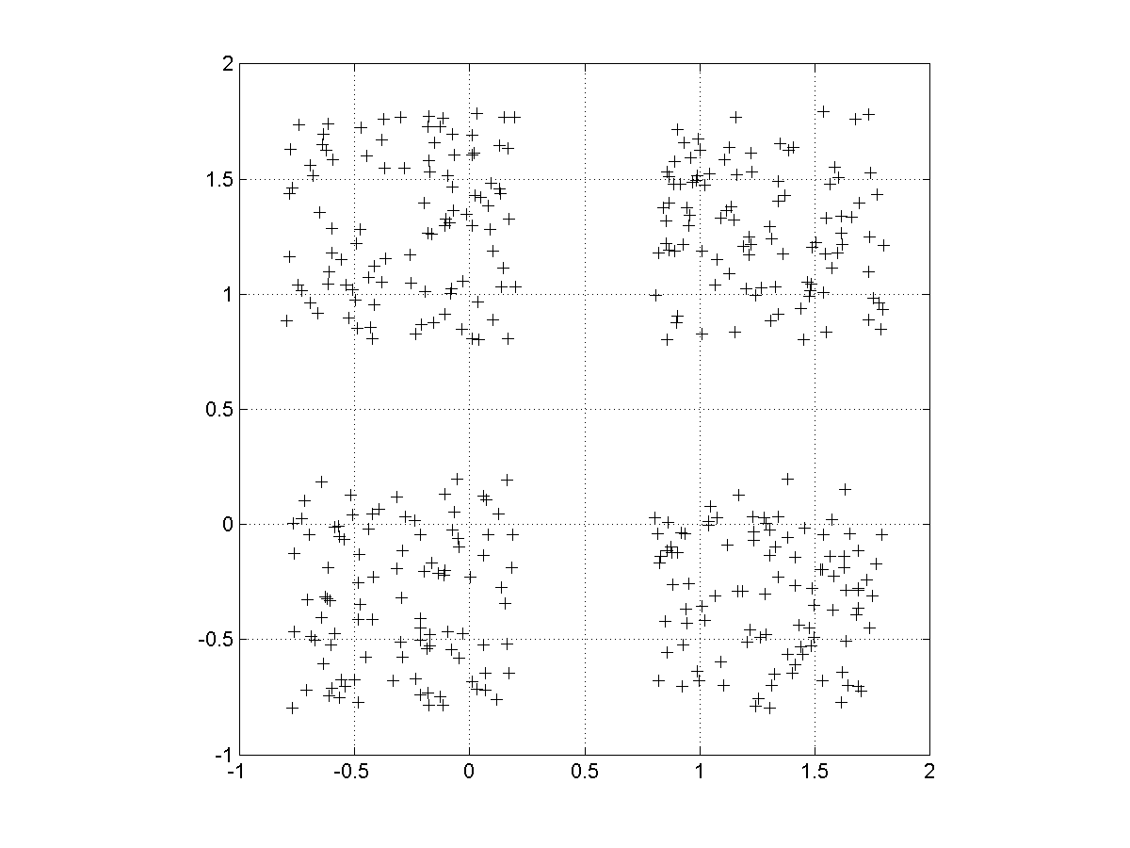
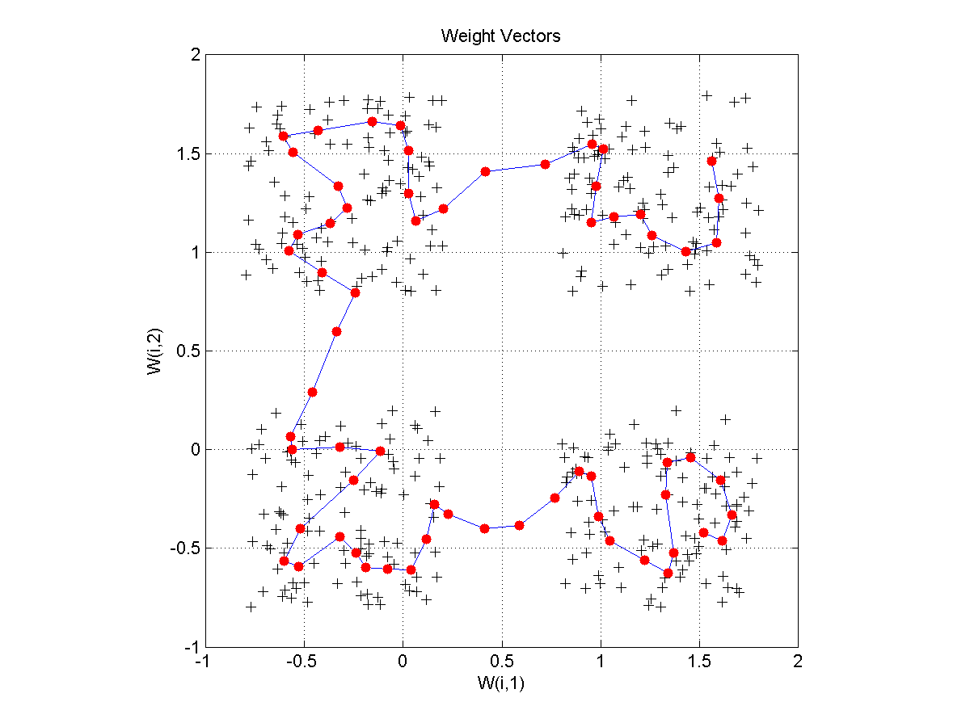
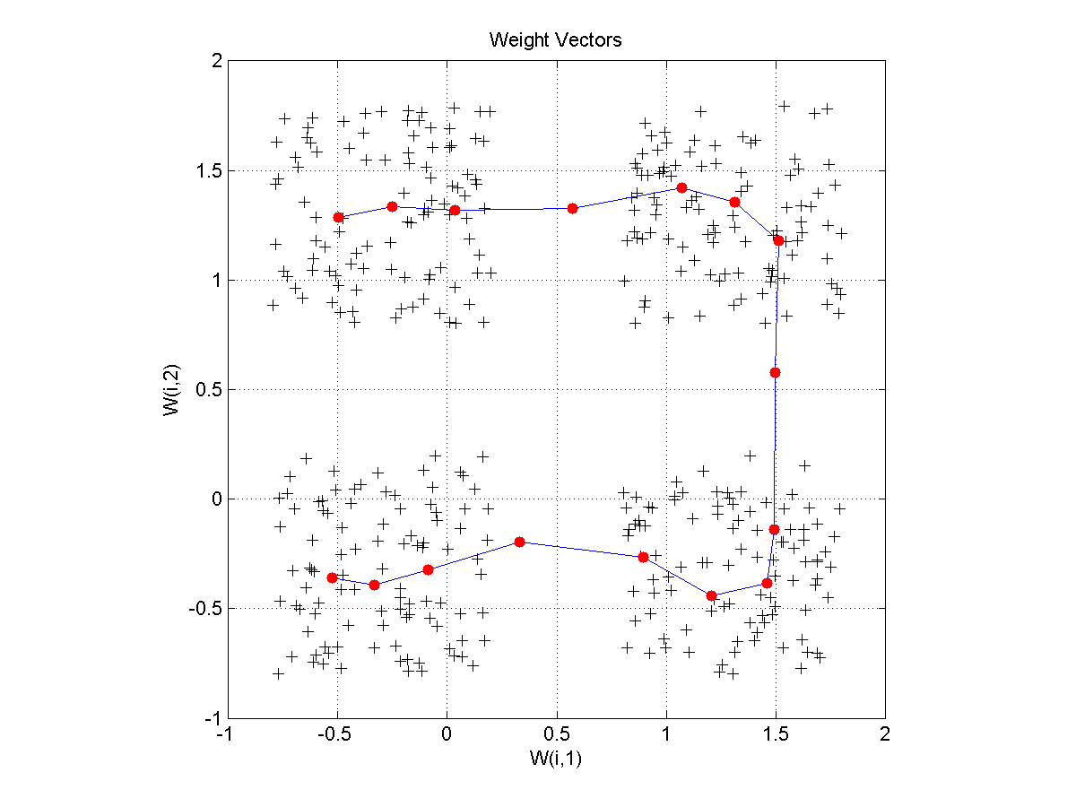
Example of 1D-SOM on 4 data clusters

Slide 38
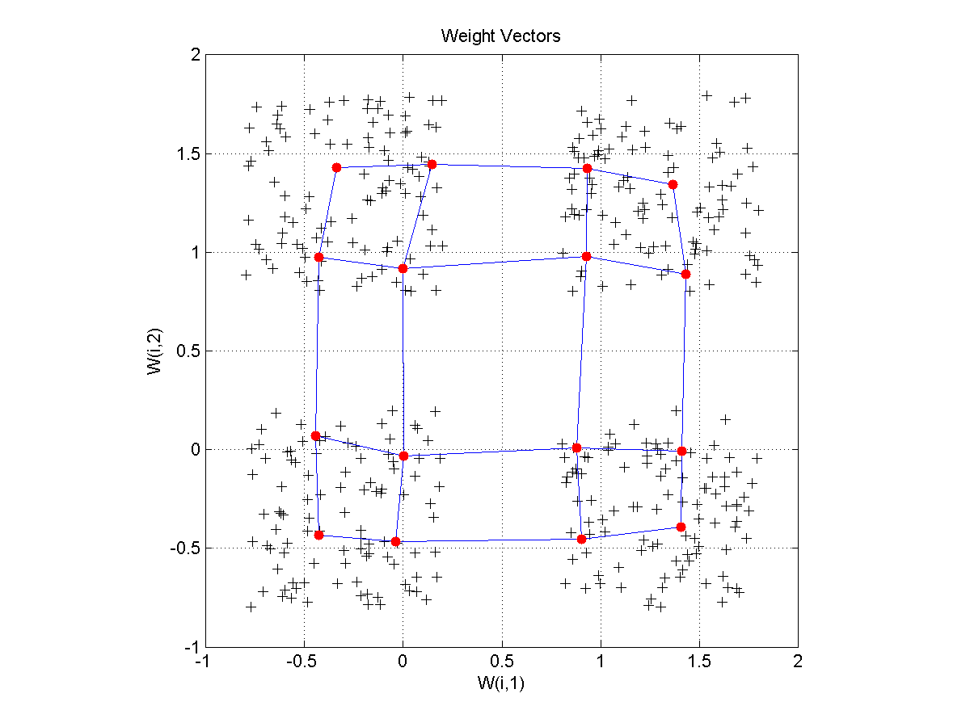
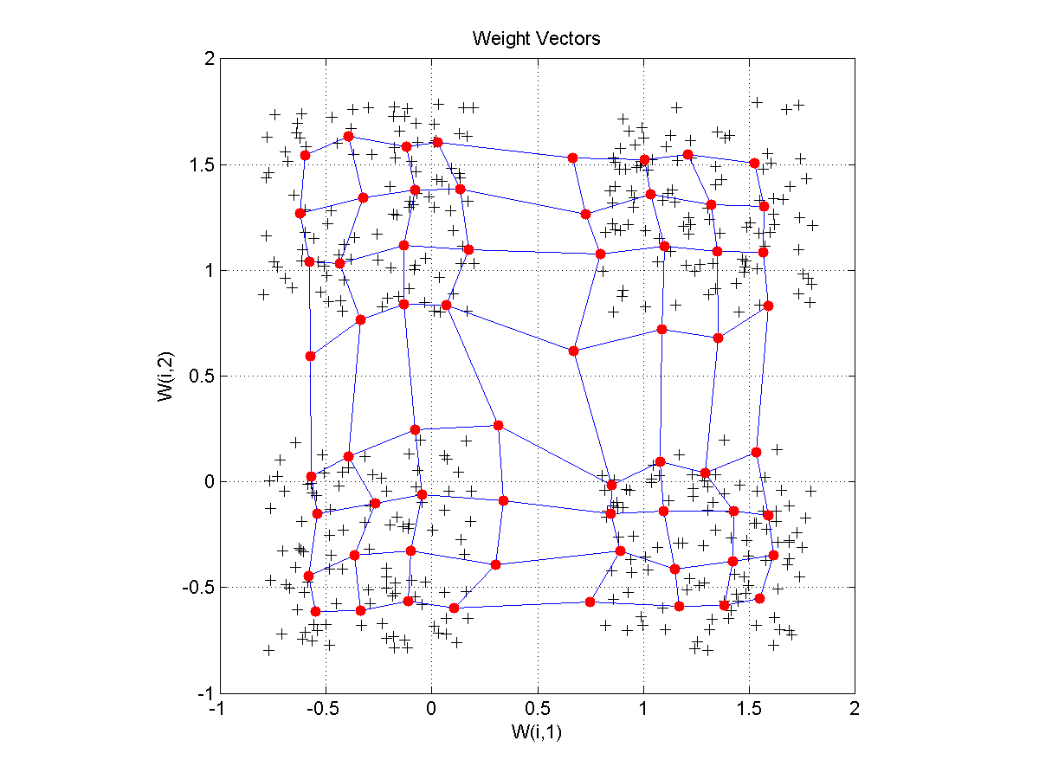
Example of 2D-SOM on 4 data clusters

Slide 39
Uniform distribution, square
50 neurons
Uniform distribution of 1000 points in a square
10x10 neurons

Slide 40
Uniform distribution, circle
50 neurons
Uniform distribution of 1000 points in a circle
10x10 neurons

Slide 41
Gaussian distribution, square
50 neurons
10x10 neurons
Gaussian distribution of 1000 points in a square

Slide 42
Complex distribution
50 neurons
10x10 neurons
Complex distribution in a square

Slide 43
4 clusters, 2D SOM
4 classes with uniform distribution
of 1000 points in each class
Net – 8x8 neurons

Slide 44
7.6 MATLAB Live Script examples
NN7b_SOM.mlx
Construct 1-dimensional and 2-dimensional SOM networks to represent the 2-dimensional input space.

